Slide 1
Blacktown Chinese Christian Church
Welcome to Our English Service 08.03.2026
English Service 9:45 – 11:00 am
Worship Songs: Passage: Speaker: Topic: Response Song: Announcements and Closing Prayer Benediction
Nothing but the blood Build my life Yet not I but through Christ Gal 2:15-21 Xavier Lakshmanan Geneuine Christian Life

Slide 2
BCCC english service

Slide 3
Nothing But The Blood Of Jesus
CCLI Licence No: 5485849

Slide 4
What can wash away my sin?
Nothing but the blood of Jesus
What can make me whole again?
Nothing but the blood of Jesus

Slide 5
For my pardon this I see
Nothing but the blood of Jesus
For my cleansing this my plea
Nothing but the blood of Jesus

Slide 6
Oh, precious is the flow
That makes me white as snow
No other fount I know
Nothing but the blood of Jesus

Slide 7
This is all my hope and peace
Nothing but the blood of Jesus
This is all my righteousness
Nothing but the blood of Jesus

Slide 8
Oh, precious is the flow
That makes me white as snow
No other fount I know
Nothing but the blood of Jesus

Slide 9
Glory glory this I see
Nothing but the blood of Jesus
All my praise for this I bring
Nothing but the blood of Jesus

Slide 10
Oh, precious is the flow
That makes me white as snow
No other fount I know
Nothing but the blood of Jesus (x2)

Slide 11
Build My Life
CCLI Licence No: 5485849

Slide 12
Worthy of every song we could ever sing
Worthy of all the praise we could ever bring
Worthy of every breath we could ever breathe
We live for You

Slide 13
Jesus, the name above every other name
Jesus, the only one who could ever save
Worthy of every breath we could ever breathe
We live for You

Slide 14
Holy, there is no one like You
There is none beside You
Open up my eyes in wonder

Slide 15
Show me who You are
And fill me with Your heart
And lead me in Your love to those around me

Slide 16
Worthy of every song we could ever sing
Worthy of all the praise we could ever bring
Worthy of every breath we could ever breathe
We live for You

Slide 17
Jesus, the name above every other name
Jesus, the only one who could ever save
Worthy of every breath we could ever breathe
We live for You

Slide 18
Holy, there is no one like You
There is none beside You
Open up my eyes in wonder

Slide 19
Show me who You are
And fill me with Your heart
And lead me in Your love to those around me

Slide 20
Holy, there is no one like You
There is none beside You
Open up my eyes in wonder

Slide 21
Show me who You are
And fill me with Your heart
And lead me in Your love to those around me

Slide 22
I will build my life upon Your love
It is a firm foundation
I will put my trust in You alone
And I will not be shaken (x2)

Slide 23
Holy, there is no one like You
There is none beside You
Open up my eyes in wonder

Slide 24
Show me who You are
And fill me with Your heart
And lead me in Your love to those around me

Slide 25
Holy, there is no one like You
There is none beside You
Open up my eyes in wonder

Slide 26
Show me who You are
And fill me with Your heart
And lead me in Your love to those around me

Slide 27
I will build my life upon Your love
It is a firm foundation
I will put my trust in You alone
And I will not be shaken

Slide 28
Yet Not I But Through Christ In Me
CCLI Licence No: 5485849

Slide 29
What gift of grace is Jesus, my Redeemer
There is no more for heaven now to give
He is my joy, my righteousness and freedom
My steadfast love, my deep and boundless peace

Slide 30
To this I hold, my hope is only Jesus
For my life is wholly bound to His
Oh how strange and divine, I can sing "All is mine"
Yet not I, but through Christ in me

Slide 31
The night is dark but I am not forsaken
For by my side, the Savior He will stay
I labour on in weakness and rejoicing
For in my need, His power is displayed

Slide 32
To this I hold, my Shepherd will defend me
Through the deepest valley He will lead
Oh the night has been won and I shall overcome
Yet not I, but through Christ in me

Slide 33
No fate I dread, I know I am forgiven
The future sure, the price it has been paid
For Jesus bled and suffered for my pardon
And He was raised to overthrow the grave

Slide 34
To this I hold, my sin has been defeated
Jesus now and ever is my plea
All the chains are released, I can sing "I am free"
Yet not I, but through Christ in me

Slide 35
With every breath, I long to follow Jesus
For He has said that He will bring me home
And day by day, I know He will renew me
Until I stand with joy before the throne

Slide 36
To this I hold, my hope is only Jesus
All the glory evermore to Him
When the race is complete, still my lips shall repeat
"Yet not I, but through Christ in me"

Slide 37
When the race is complete, still my lips shall repeat
"Yet not I, but through Christ in me"
"Yet not I, but through Christ in me"
"Yet not I, but through Christ in me"

Slide 38
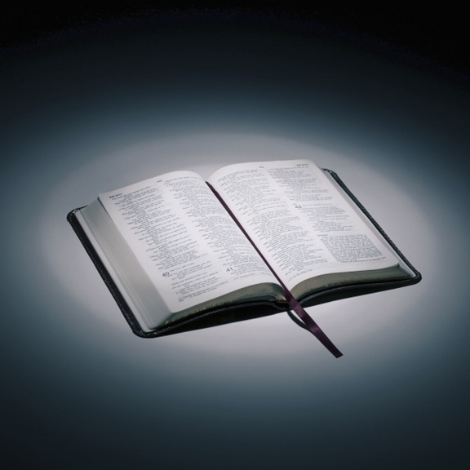
Bible reading

Slide 39
Gal 2:15-21
¹⁵ “We who are Jews by birth and not sinful Gentiles ¹⁶ know that a person is not justified by the works of the law, but by faith in Jesus Christ. So we, too, have put our faith in Christ Jesus that we may be justified by faith in Christ and not by the works of the law, because by the works of the law no one will be justified.

Slide 40
Gal 2:15-21
¹⁷ “But if, in seeking to be justified in Christ, we Jews find ourselves also among the sinners, doesn’t that mean that Christ promotes sin? Absolutely not! ¹⁸ If I rebuild what I destroyed, then I really would be a lawbreaker.

Slide 41
Gal 2:15-21
¹⁹ “For through the law I died to the law so that I might live for God. ²⁰ I have been crucified with Christ and I no longer live, but Christ lives in me. The life I now live in the body, I live by faith in the Son of God, who loved me and gave himself for me.

Slide 42
Gal 2:15-21
²¹ I do not set aside the grace of God, for if righteousness could be gained through the law, Christ died for nothing!”

Slide 43
Announcements

Slide 44





Account name: Blacktown Chinese Christian Church
Account number: 4216 50263
Offering
BSB: 112 - 879
Please put in "offering" as the reference
The offering box is available at the back of the hall

Slide 45
Prayer points

Slide 46
Mingle time!

